Slide 1
The Effects of Sulfur Dioxide on the Diné Nation
By: Brittany Jim, Jo-Dee Plummer, Ki-Jana Martinez, Chantel Becenti, and Kyle Goh

Slide 2
Table of contents:
Background & Relevance (Brittany Jim)
Dine Perspective (Brittany Jim)
Experimental Design (Kyle Goh)
Results (Kyle Goh)
Error Analysis (Jo-Dee Plummer)
Future Research Plans (group)
Acknowledgements
Questions?
Photo credit: ANSR 2017

Slide 3
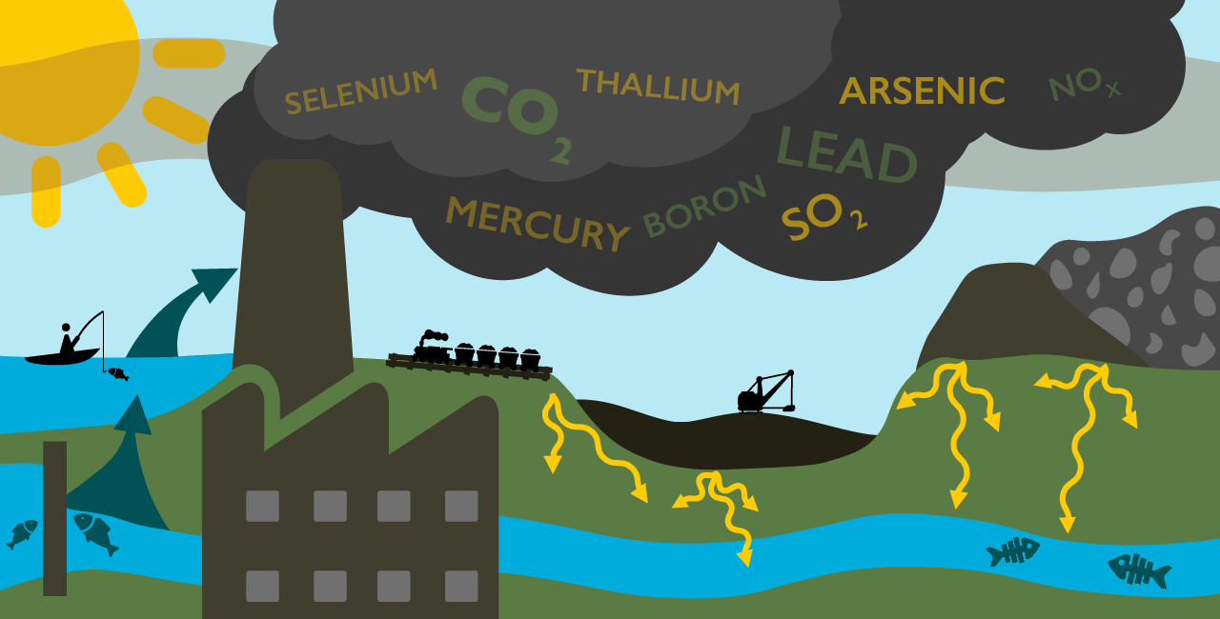
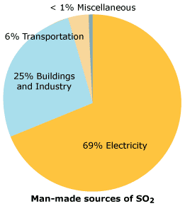
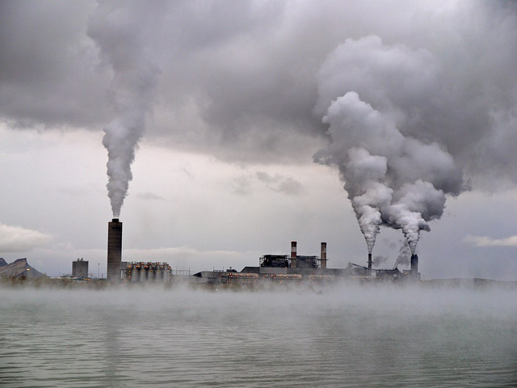
I. Background & Relevance (Brittany Jim):
What is SO2?
Sulfur Dioxide is a pollutant that’s released into our atmosphere daily.
SO2 is an important chemical compound that people, animals, and nature come into contact with on a daily basis.
←Four Corners Power plant

Slide 4
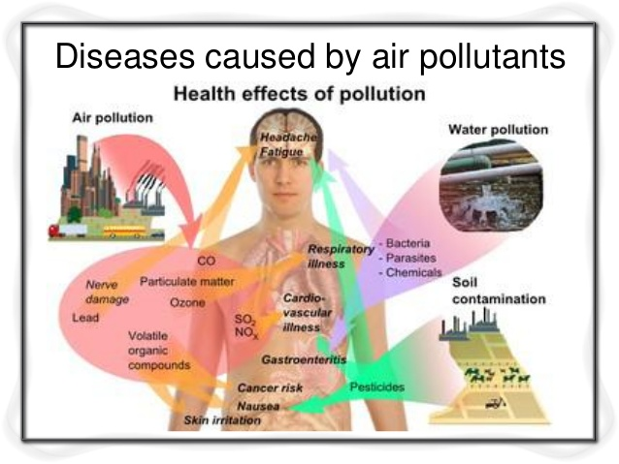
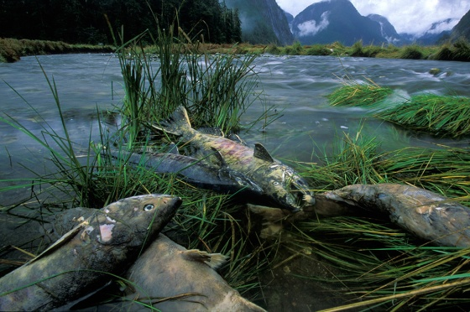
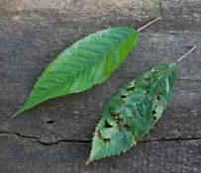
I. Background & Relevance (Brittany Jim):
According to the World Health Organization, 800,000 people die prematurely due to cardiovascular-respiratory diseases, and lung cancer resulting from air pollution throughout the world every year (Zallaghi, Soleimani, Heidari-Farsani, & Goudarzi, 2015).

Slide 5
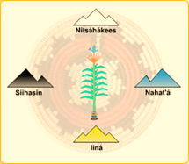
II. Dine Perspective (Brittany Jim):
Sa’ah Naaghai Bik’eh Hozhoon (SNBH):
A true-respectful relationship for one’s self, family, as well as extended kin: which includes our entire environment, cosmic order, and all creations within our universe.
If we live by SNBH then our ancestors said, “you will always breathe good clean air, have clean sunlight, & drink clear water.”

Slide 6
II. Dine Perspective (Brittany Jim):
Today the lifestyle and actions of many don’t fully meet SNBH 100%.
As a result from our actions I believe the atmosphere is polluted, our water and natural environment are dying and drying up, many animals are going extinct, our earth is getting warmer, and our breath of life is not as it should be.
“7 generations concept”
Elders say, “you are like a plant, take care of yourself and your surroundings & you will bloom healthy”.
“Nahasdzaan Shima”
“Nilch’i Diyin”

Slide 7
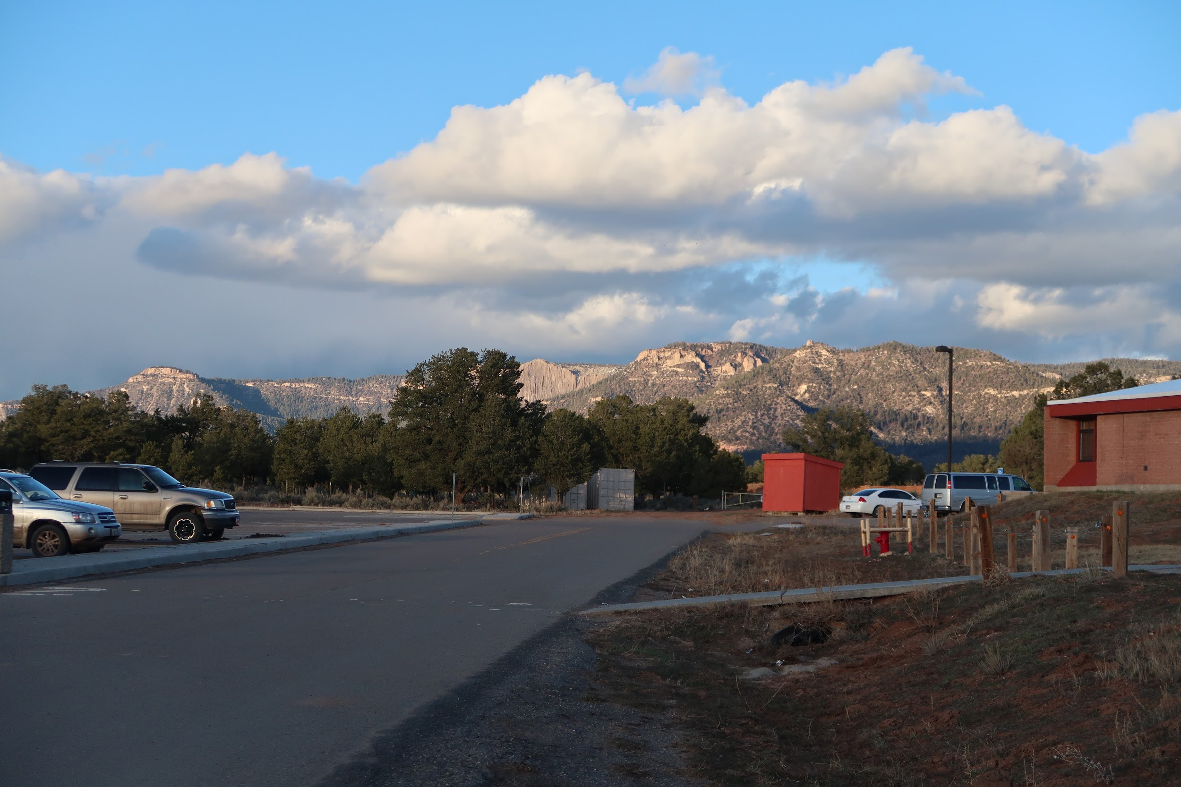
III. Experimental Design (Kyle Goh):
Hypothesis:The measurements of SO2 in the atmosphere would increase as the helium balloon traveled from Dine College Campus over the Chuska Mountains to the east.
We hypothesized this because there are two coal generated power plants within the area. There is also a visible haze above the area which could contribute to higher concentrations of SO2.

Slide 8
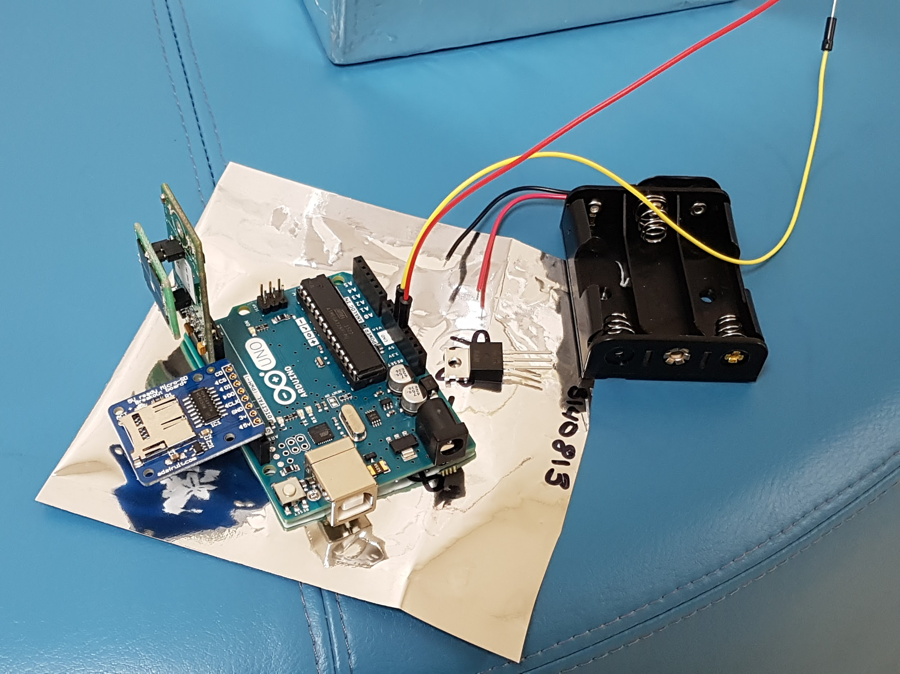
III. Experimental Design (Kyle Goh):
Instrument: SO2 Spec Sensor, an electrochemical sensor.
Why did we pick this sensor?
The measurement performance and the ultra-low power consumption needed for battery operation.
The small physical size was perfect for the weight limits that we were given.
The cost was low.

Slide 9
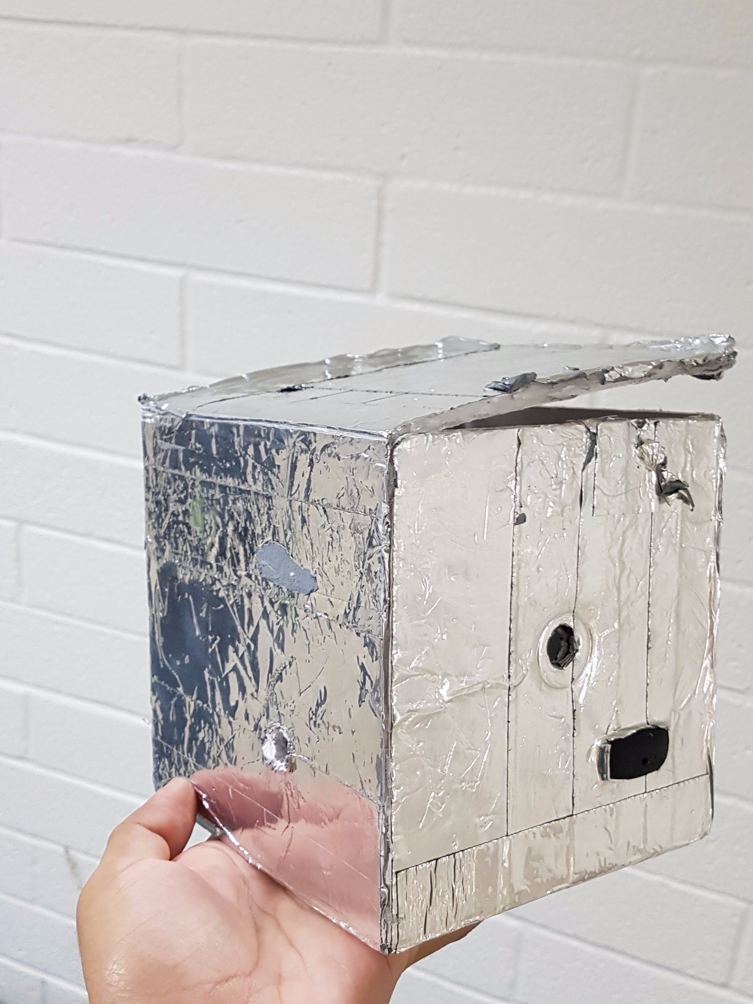
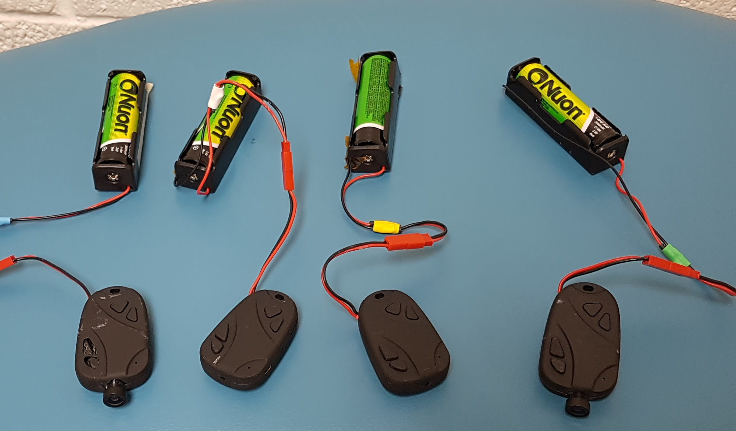
III. Experimental Design (Kyle Goh):
Plan B:
-Payload was built with 4 cameras & one temperature & pressure sensor.
-Cameras were tested.
-We built this into a secured payload.
Challenges:
-The cameras were used and had damaged buttons.
-Time constraints didn’t allow enough time for new cameras to be ordered.
-Unfortunately they didn’t collect any data.

Slide 10
IV. Error Analysis (Jodee Plummer):
-Better Group Dynamics
-Making sure group members are capable of assembling sensor before ordering.
-Time management
-Double checking equipment and doing final checks before

Slide 11
V. Future Research Plans
“Setting a good foundation for future DC students”

Slide 12
VI. Acknowledgements
-Susan Brew and AZ Space Grant Consortium
-Dr. Francis Burns (Chemistry instructor)
-Dine College

Slide 13
QUESTIONS?

